Slide 1
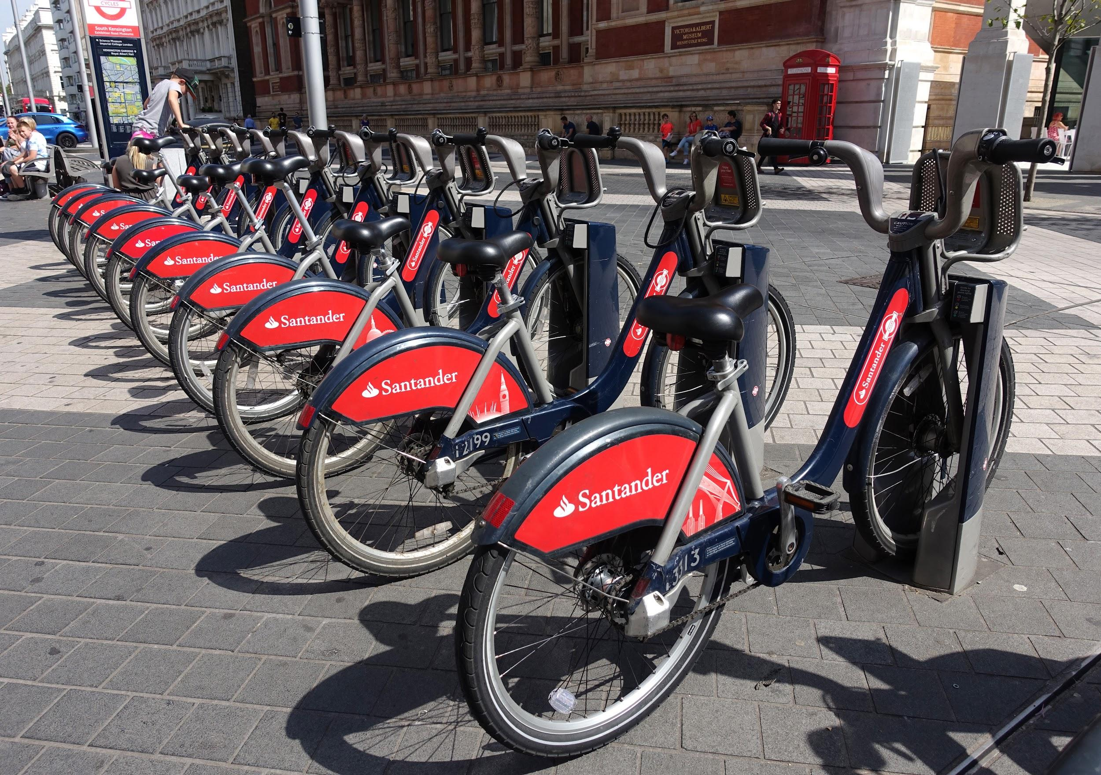
ANALYSIS OF LONDON’S BIKE SHARE

Slide 2
The London’s bike share is a bike sharing system for the public created by Santander Cycles. It is a self-service system where people who need the bicycles can get one from a docking station without external help. The dataset - London bike sharing dataset has 10 columns and 17, 414 rows. The columns include temperature, humidity, count of bike shares, wind speed, timestamp, weather code, holiday, season and weekend columns. The data spans two years beginning in January, 2015 until January, 2017.
INTRODUCTION

Slide 3
To analyze the effectiveness of the Bike sharing system, the stakeholders are looking to answer questions such as:
How do factors such as humidity, weather, temperature and wind speed affect the bike share count?
What weather has the highest count of bike share rides?
Are more bikes ridden during the holiday or non-holidays?
Are more bikes ridden during the weekday or weekend?
PROBLEM STATEMENT

Slide 4
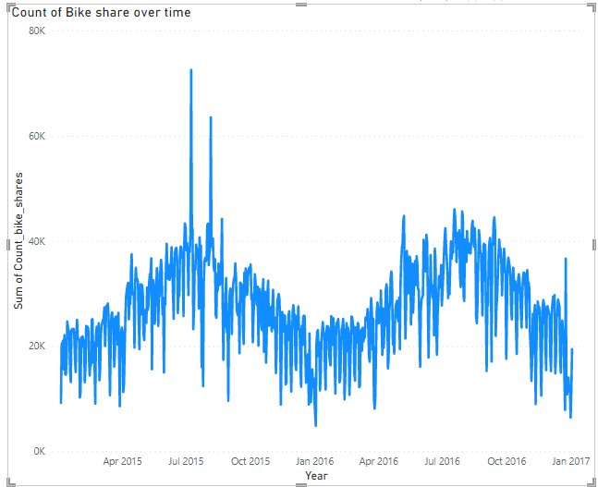
Here the curve is s-shaped with periods of peaks and dips. The peaks can be seen during the summer months beginning at the end of June until August. As the year passes, the count declines until it dips in January. The decline is associated with the change in seasons from summer to winter. This also means that the snow and icy roads are unsuitable for cycling.

Slide 5
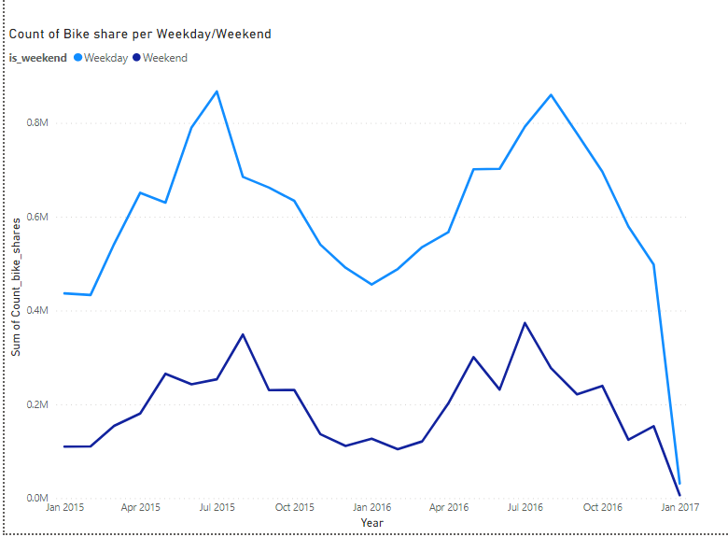
The count of bikeshare on the weekend is generally lower than that of rides for weekdays. This could be because of people commuting to work. Peaks can be seen in summer months of July and August. In winter months such as December and January, the count dips. January 2017 is particularly low because only three days have been recorded in the given data

Slide 6
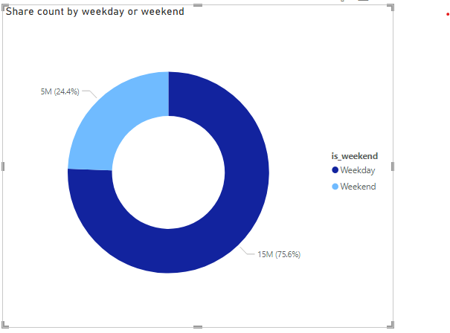
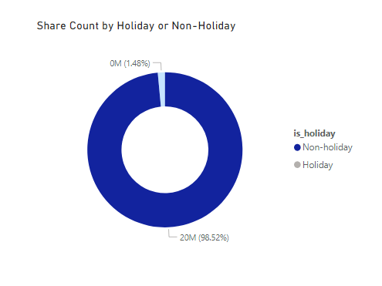
﻿﻿Rides on weekends account for a quarter of the total rideshare. This may be because of persons who go to work on weekends or commute to marketplaces and churches.
Non-holidays accounted for 98.52% of total bike share for the given period with a total of 9,610,474 rides. The count of Holiday rides was 295,498 which accounted for 1.48%. This is because holidays are usually periods of rest and most persons would have need to commute to work.

Slide 7
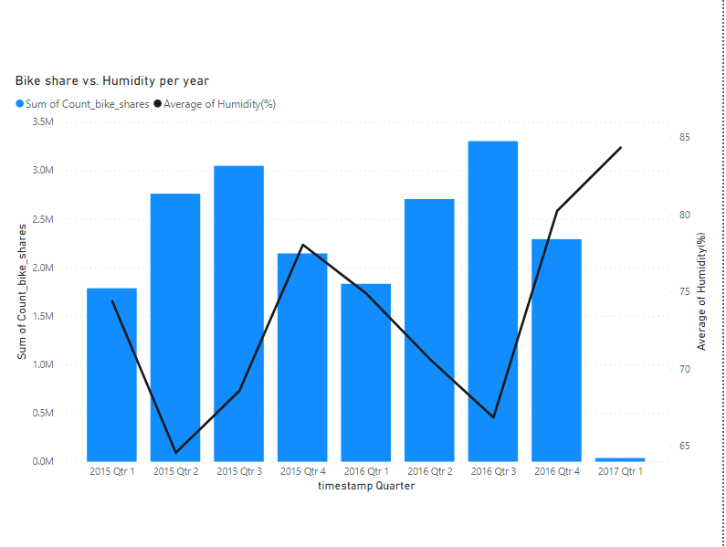
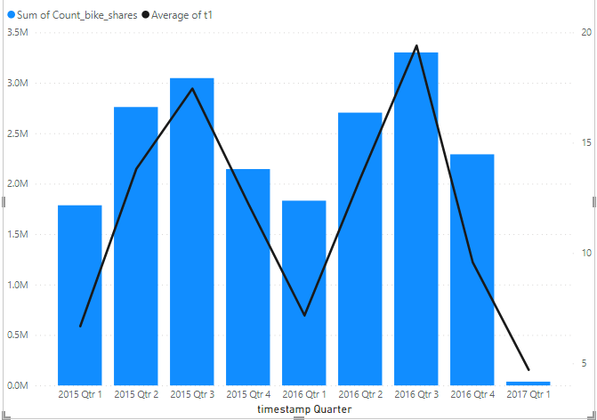
Humidity and temperature are inversely proportional. Therefore, when temperature reduces, humidity increases and thus the air becomes drier. Less rides are taken during this period. Conversely, as the temperature increases the count of bike shares also increases. Average of Humidity(%) trended up (13.37% increase) while the count of bike shares (97.89% decrease) trended down.

Slide 8
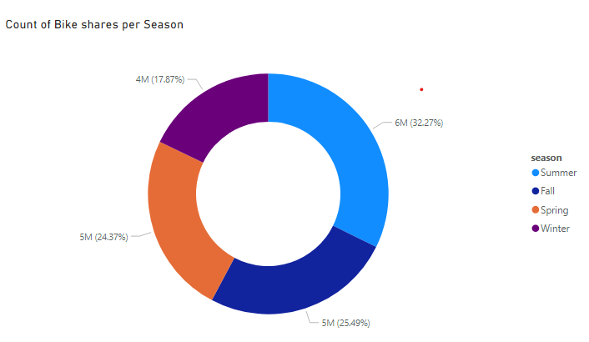
Summer had the highest sum of bike shares at 6,424,609 (32.27%). This is followed closely by Fall (25.49%), Spring (24.37%), and Winter (17.87%)

Slide 9
Given periods of peaks and decline, the bike can be docked and undocked for routine cleaning and maintenance and care during winter months.
The cycles management can also make preparations against periods when they would be a surge of riders to keep track of the cycles and plan against unforeseen circumstances.
CONCLUSION

Slide 10
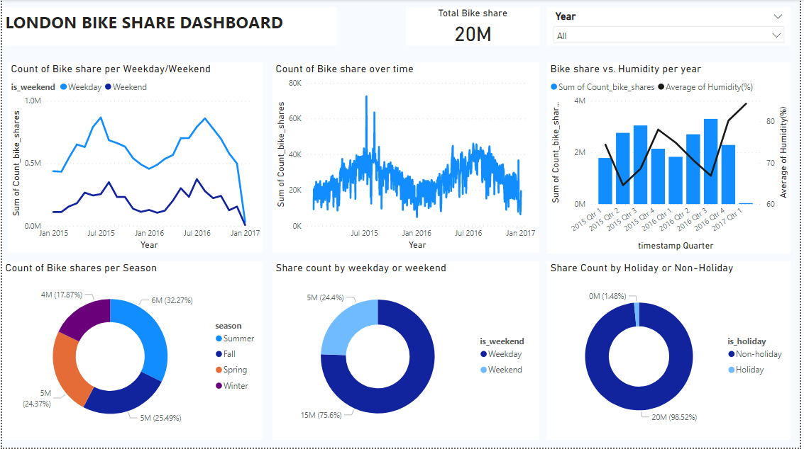

Slide 11
THANK YOU

